Slide 1
Sunnyside Up Speaker Series
March 25, 2025

Slide 2
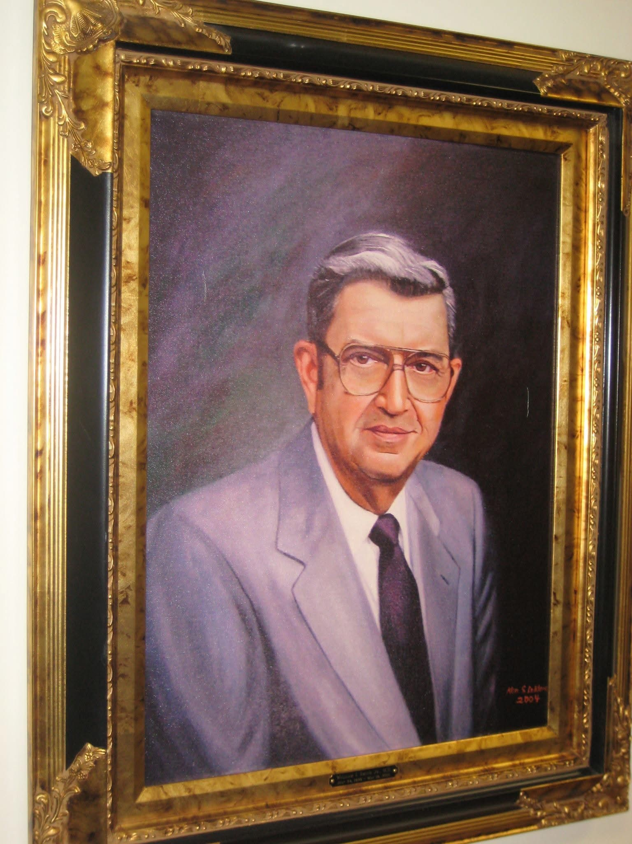
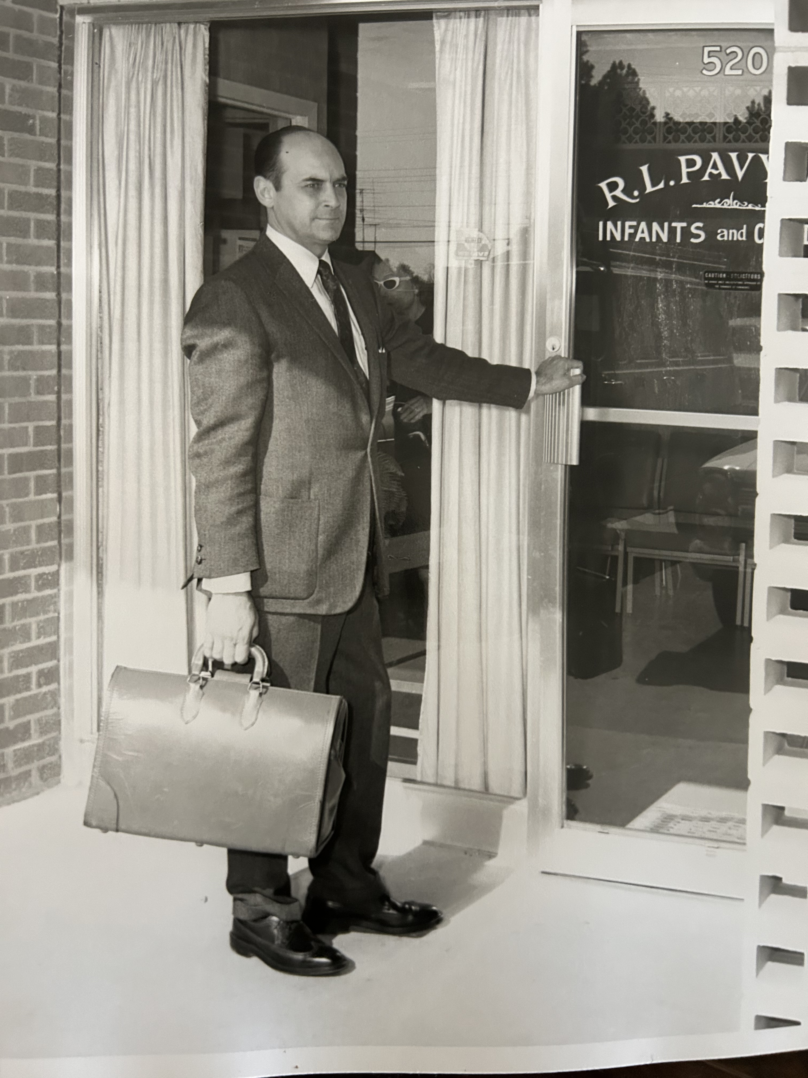
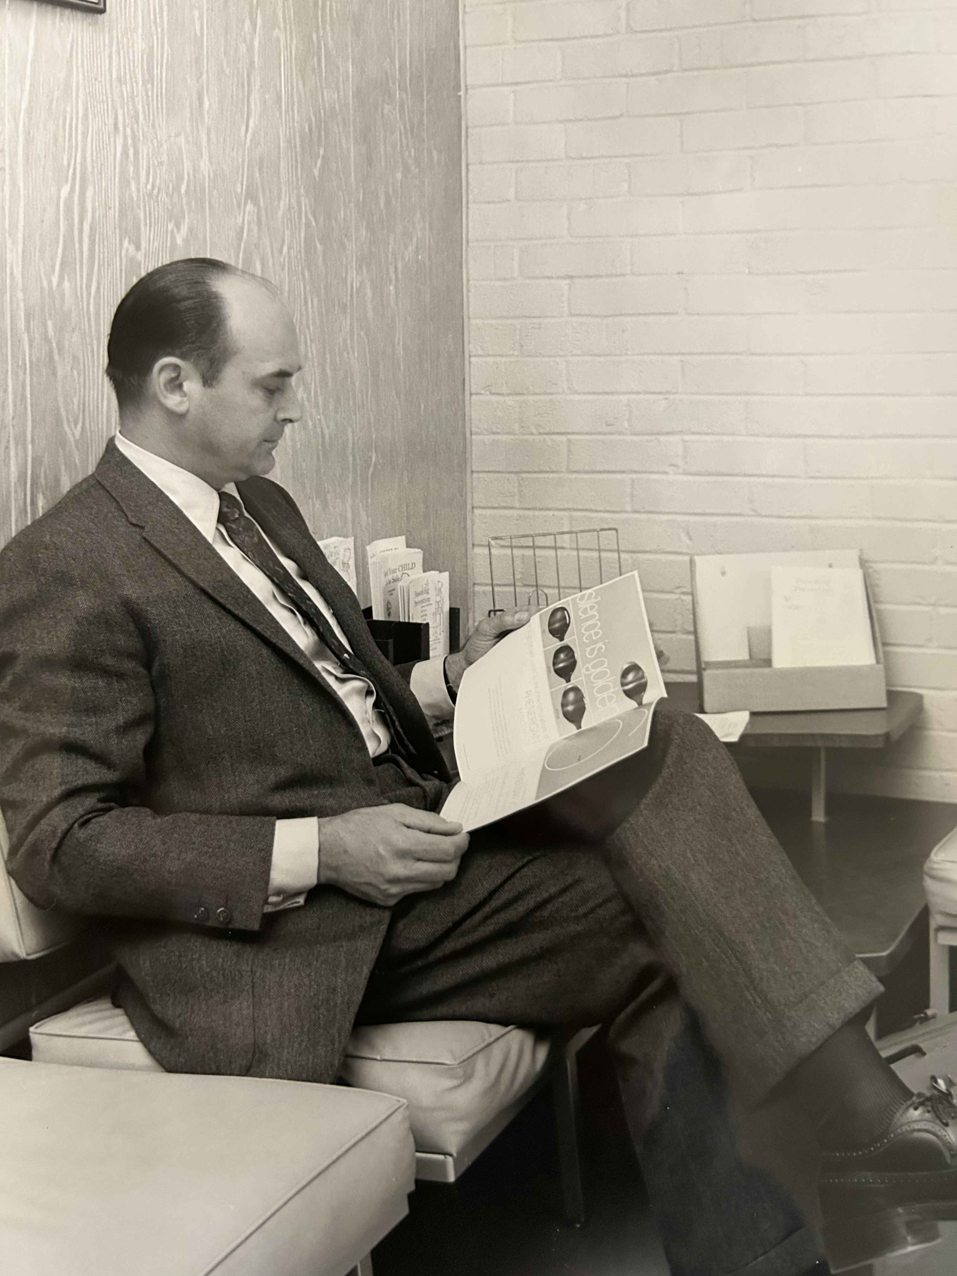

Slide 3
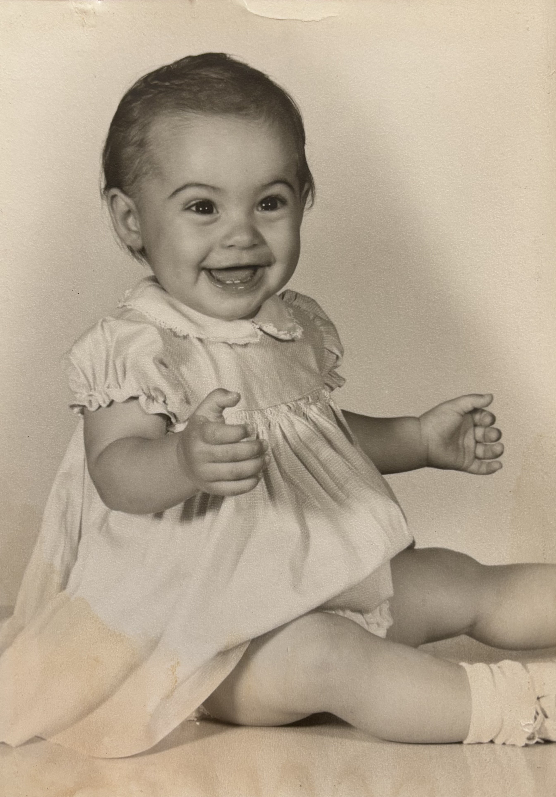
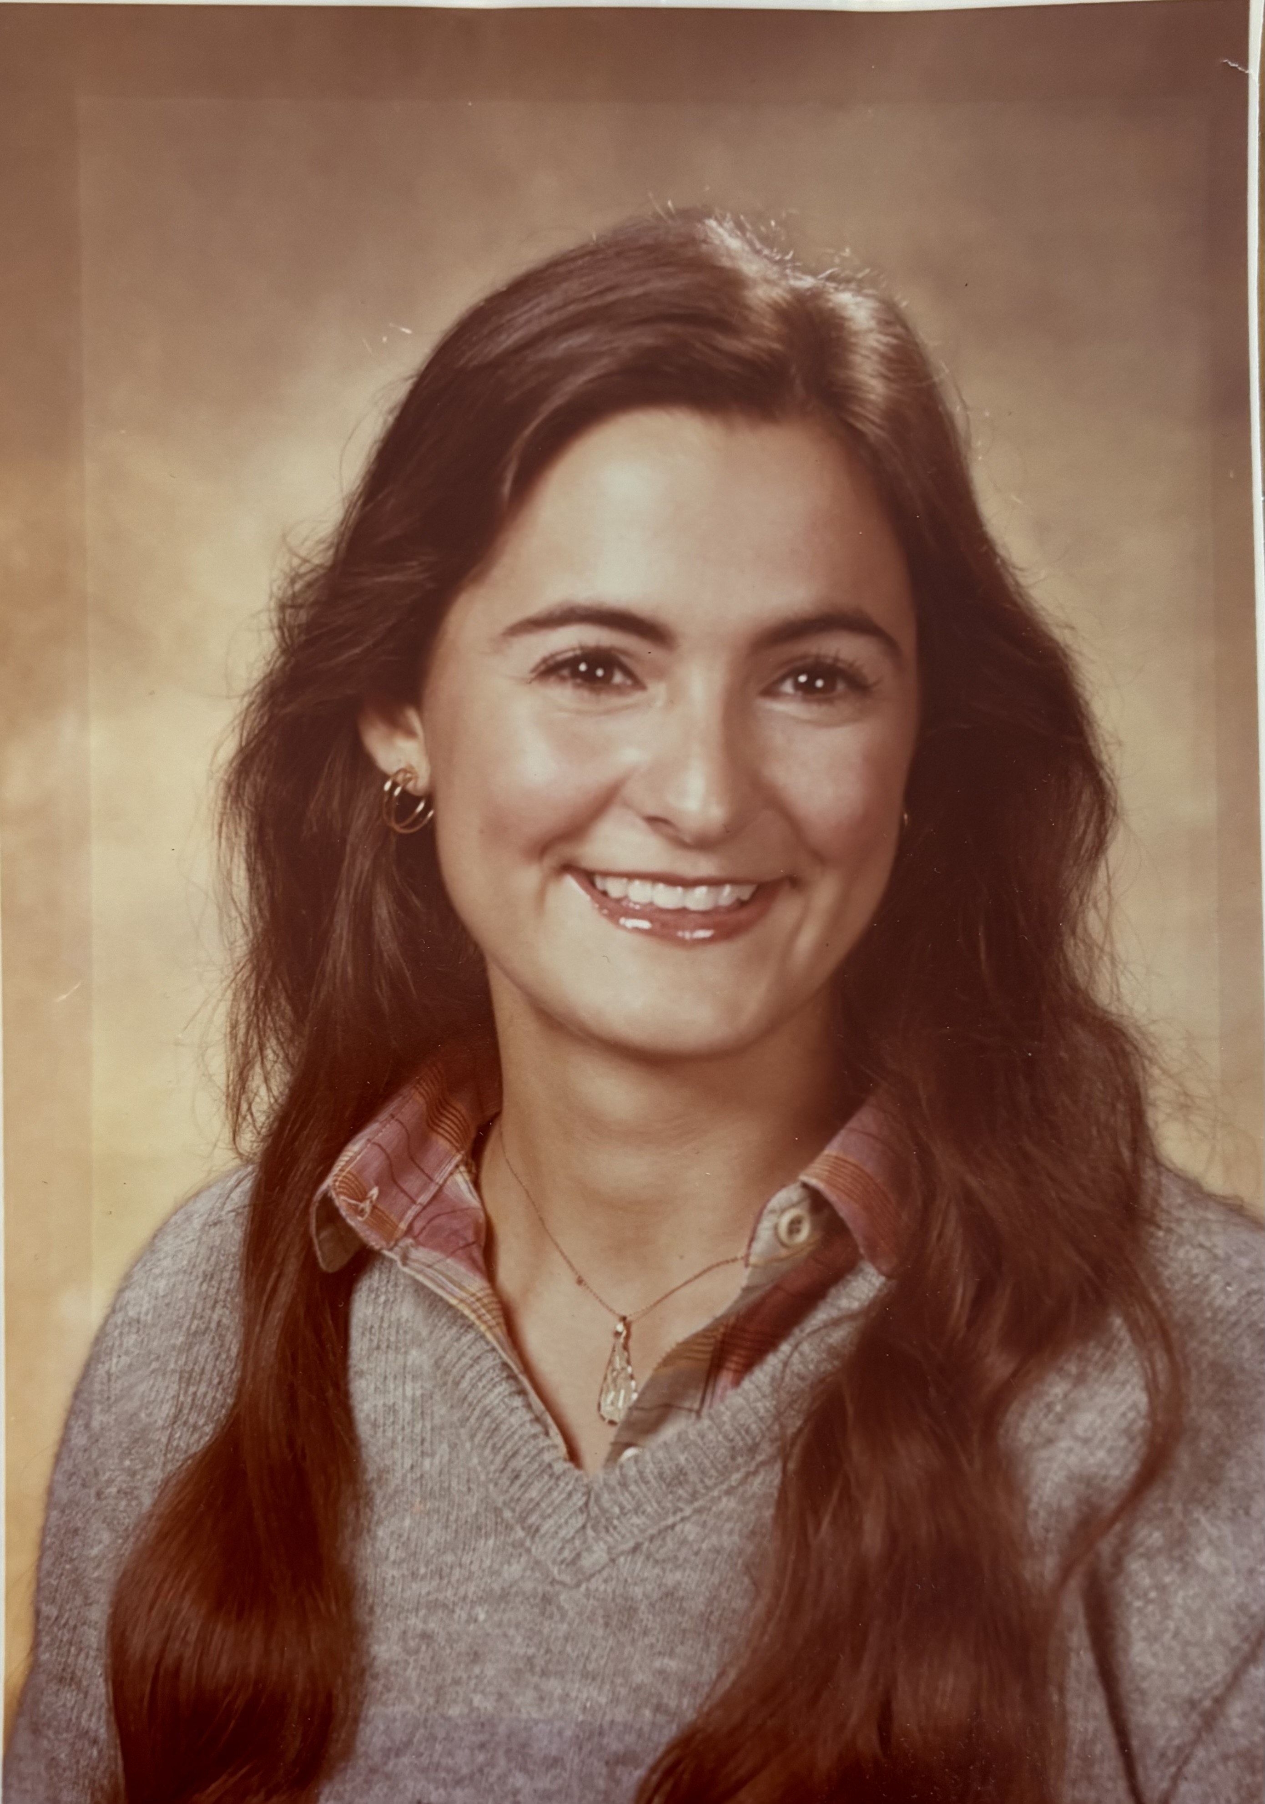
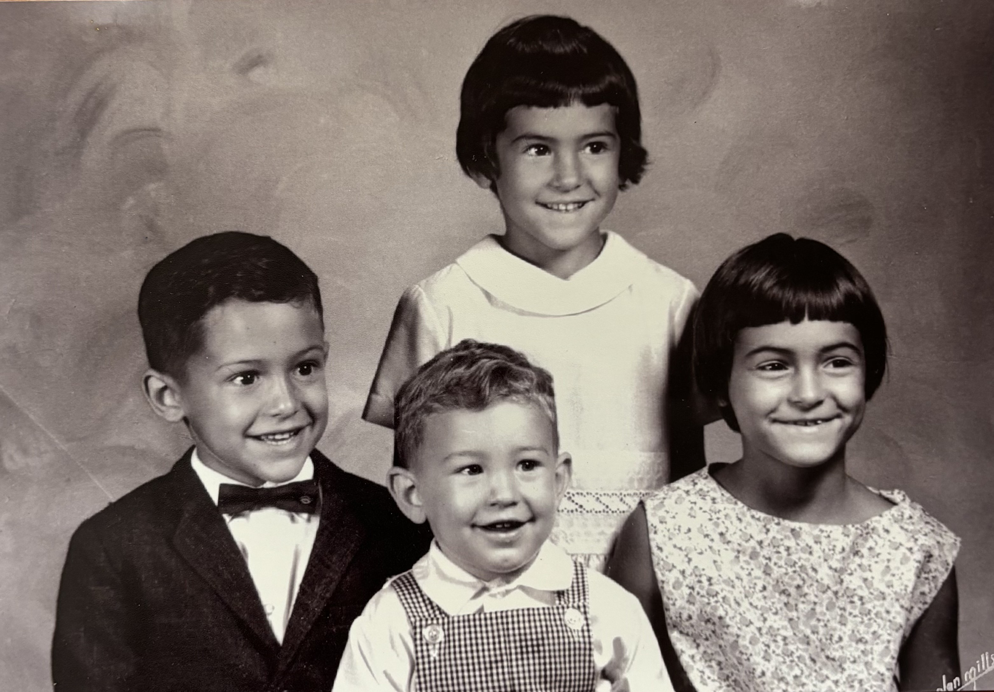

Slide 4
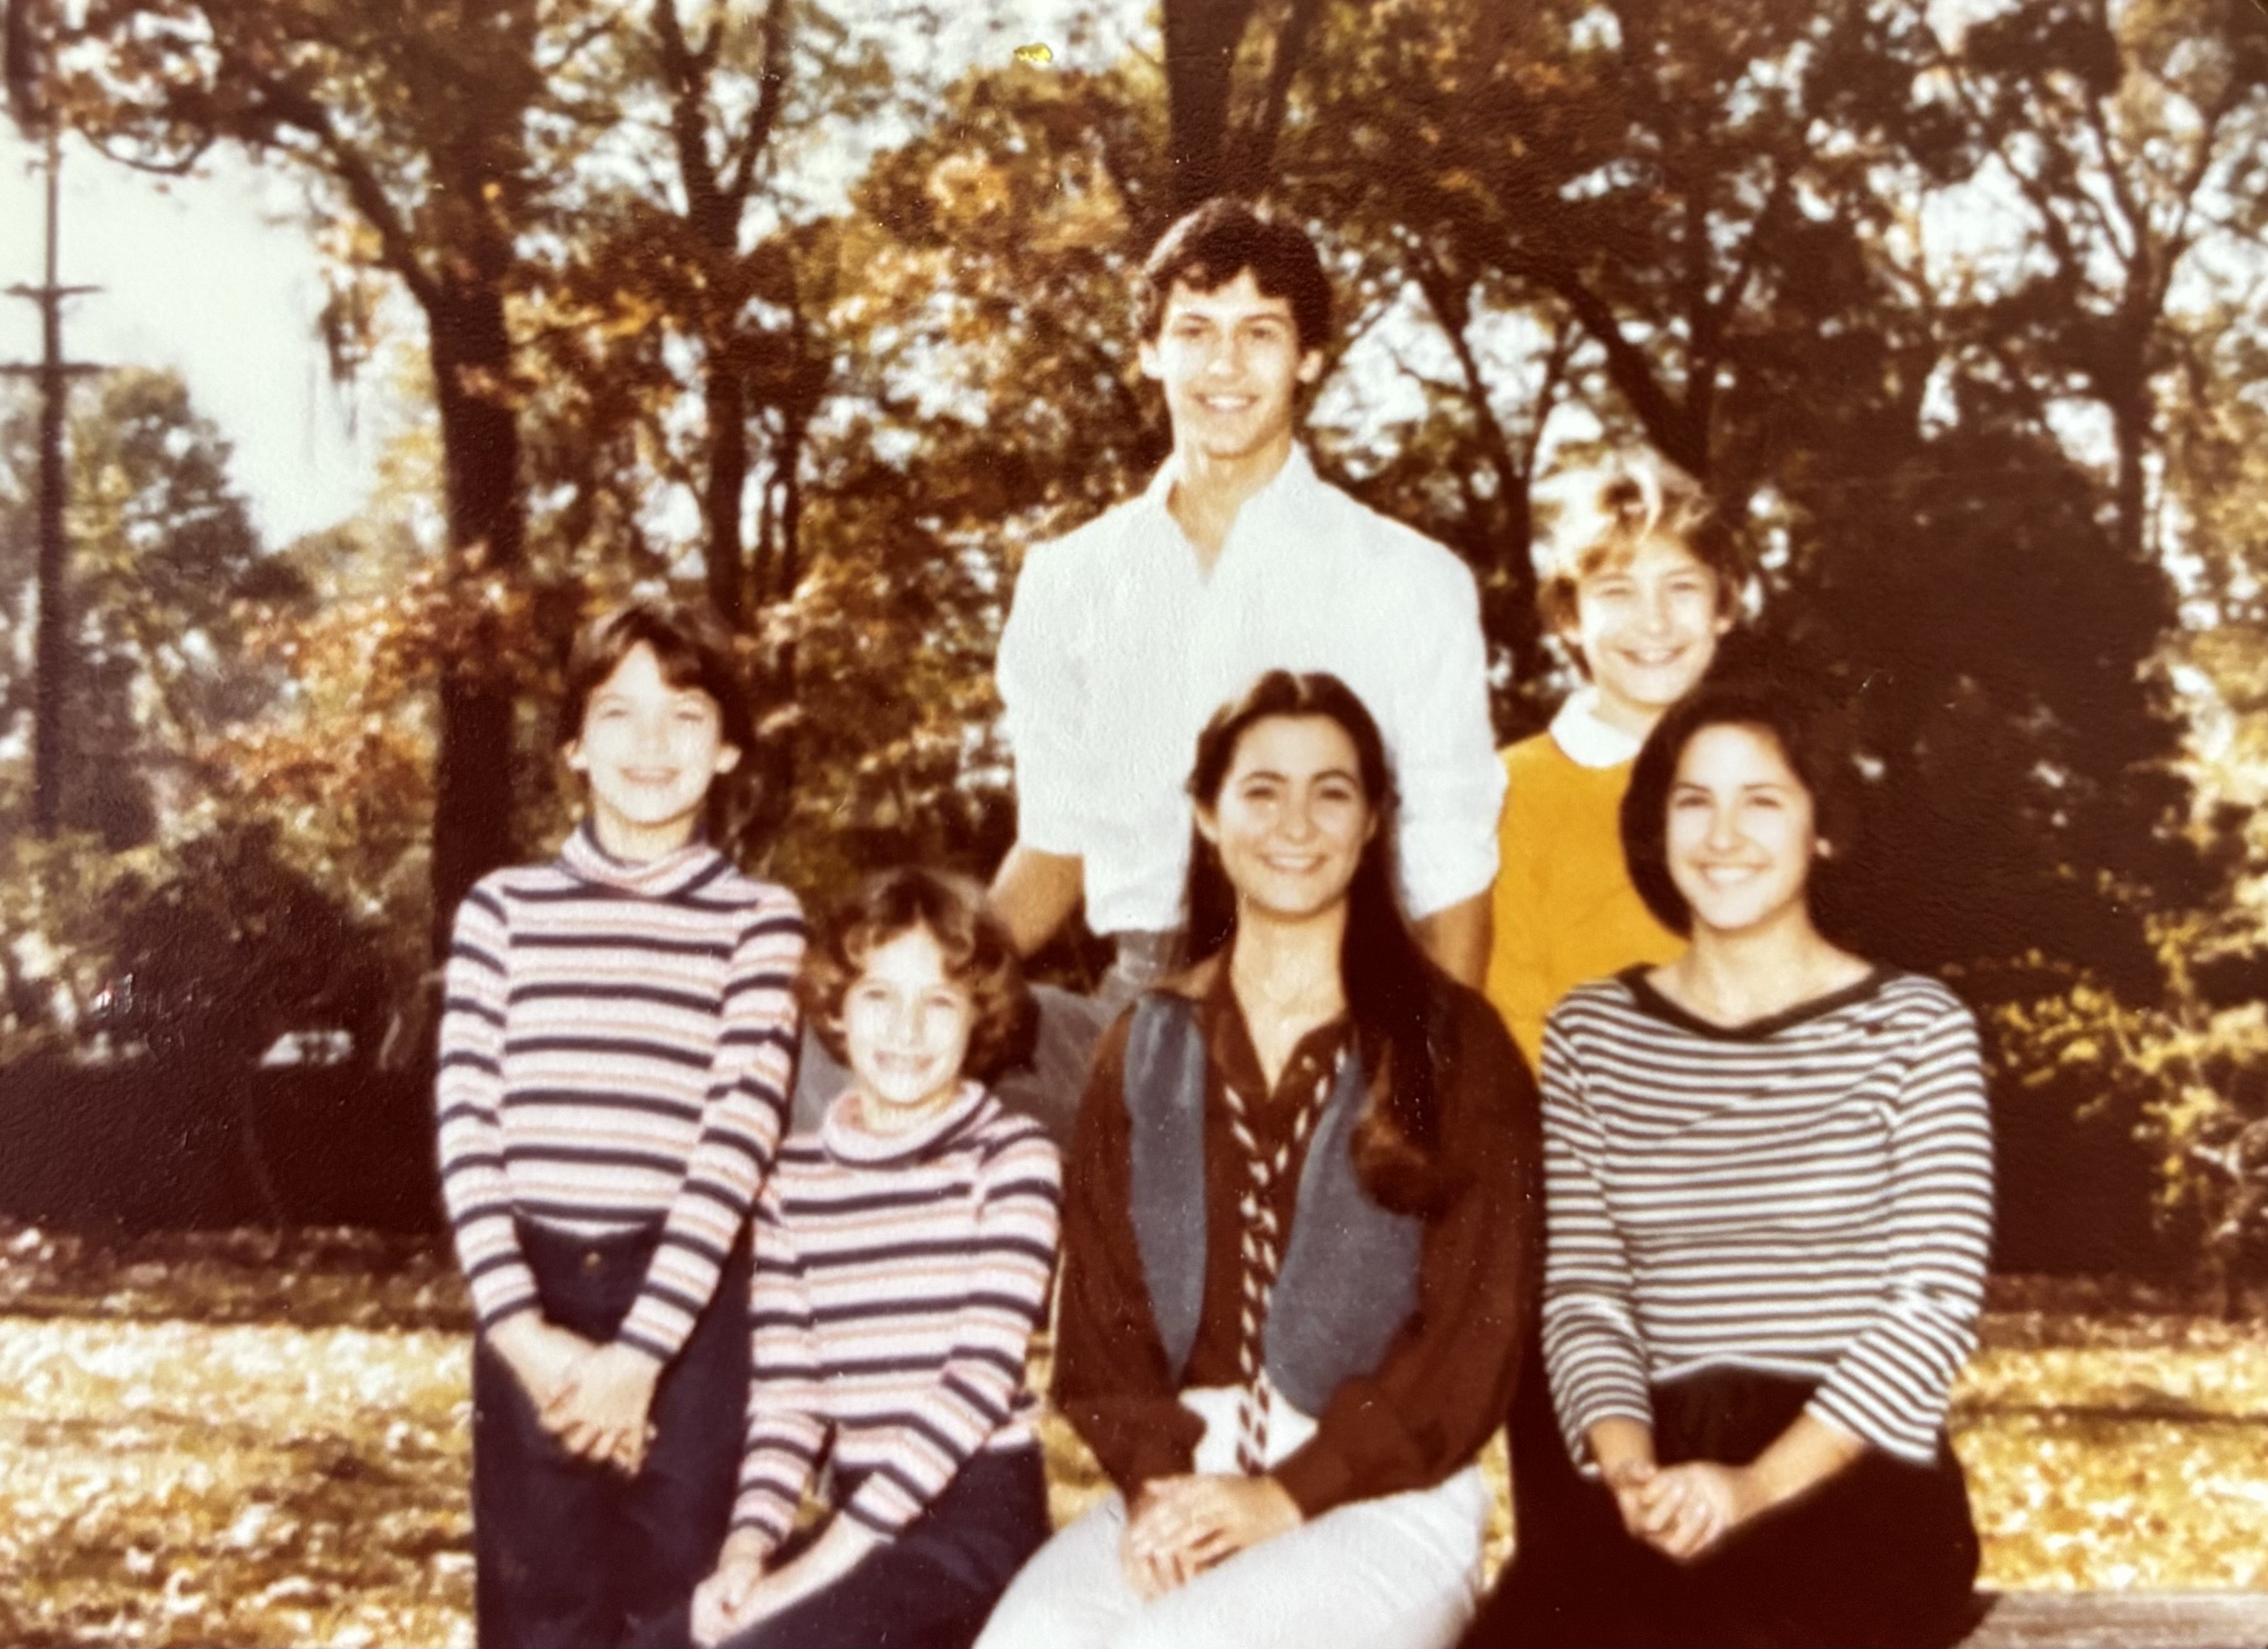
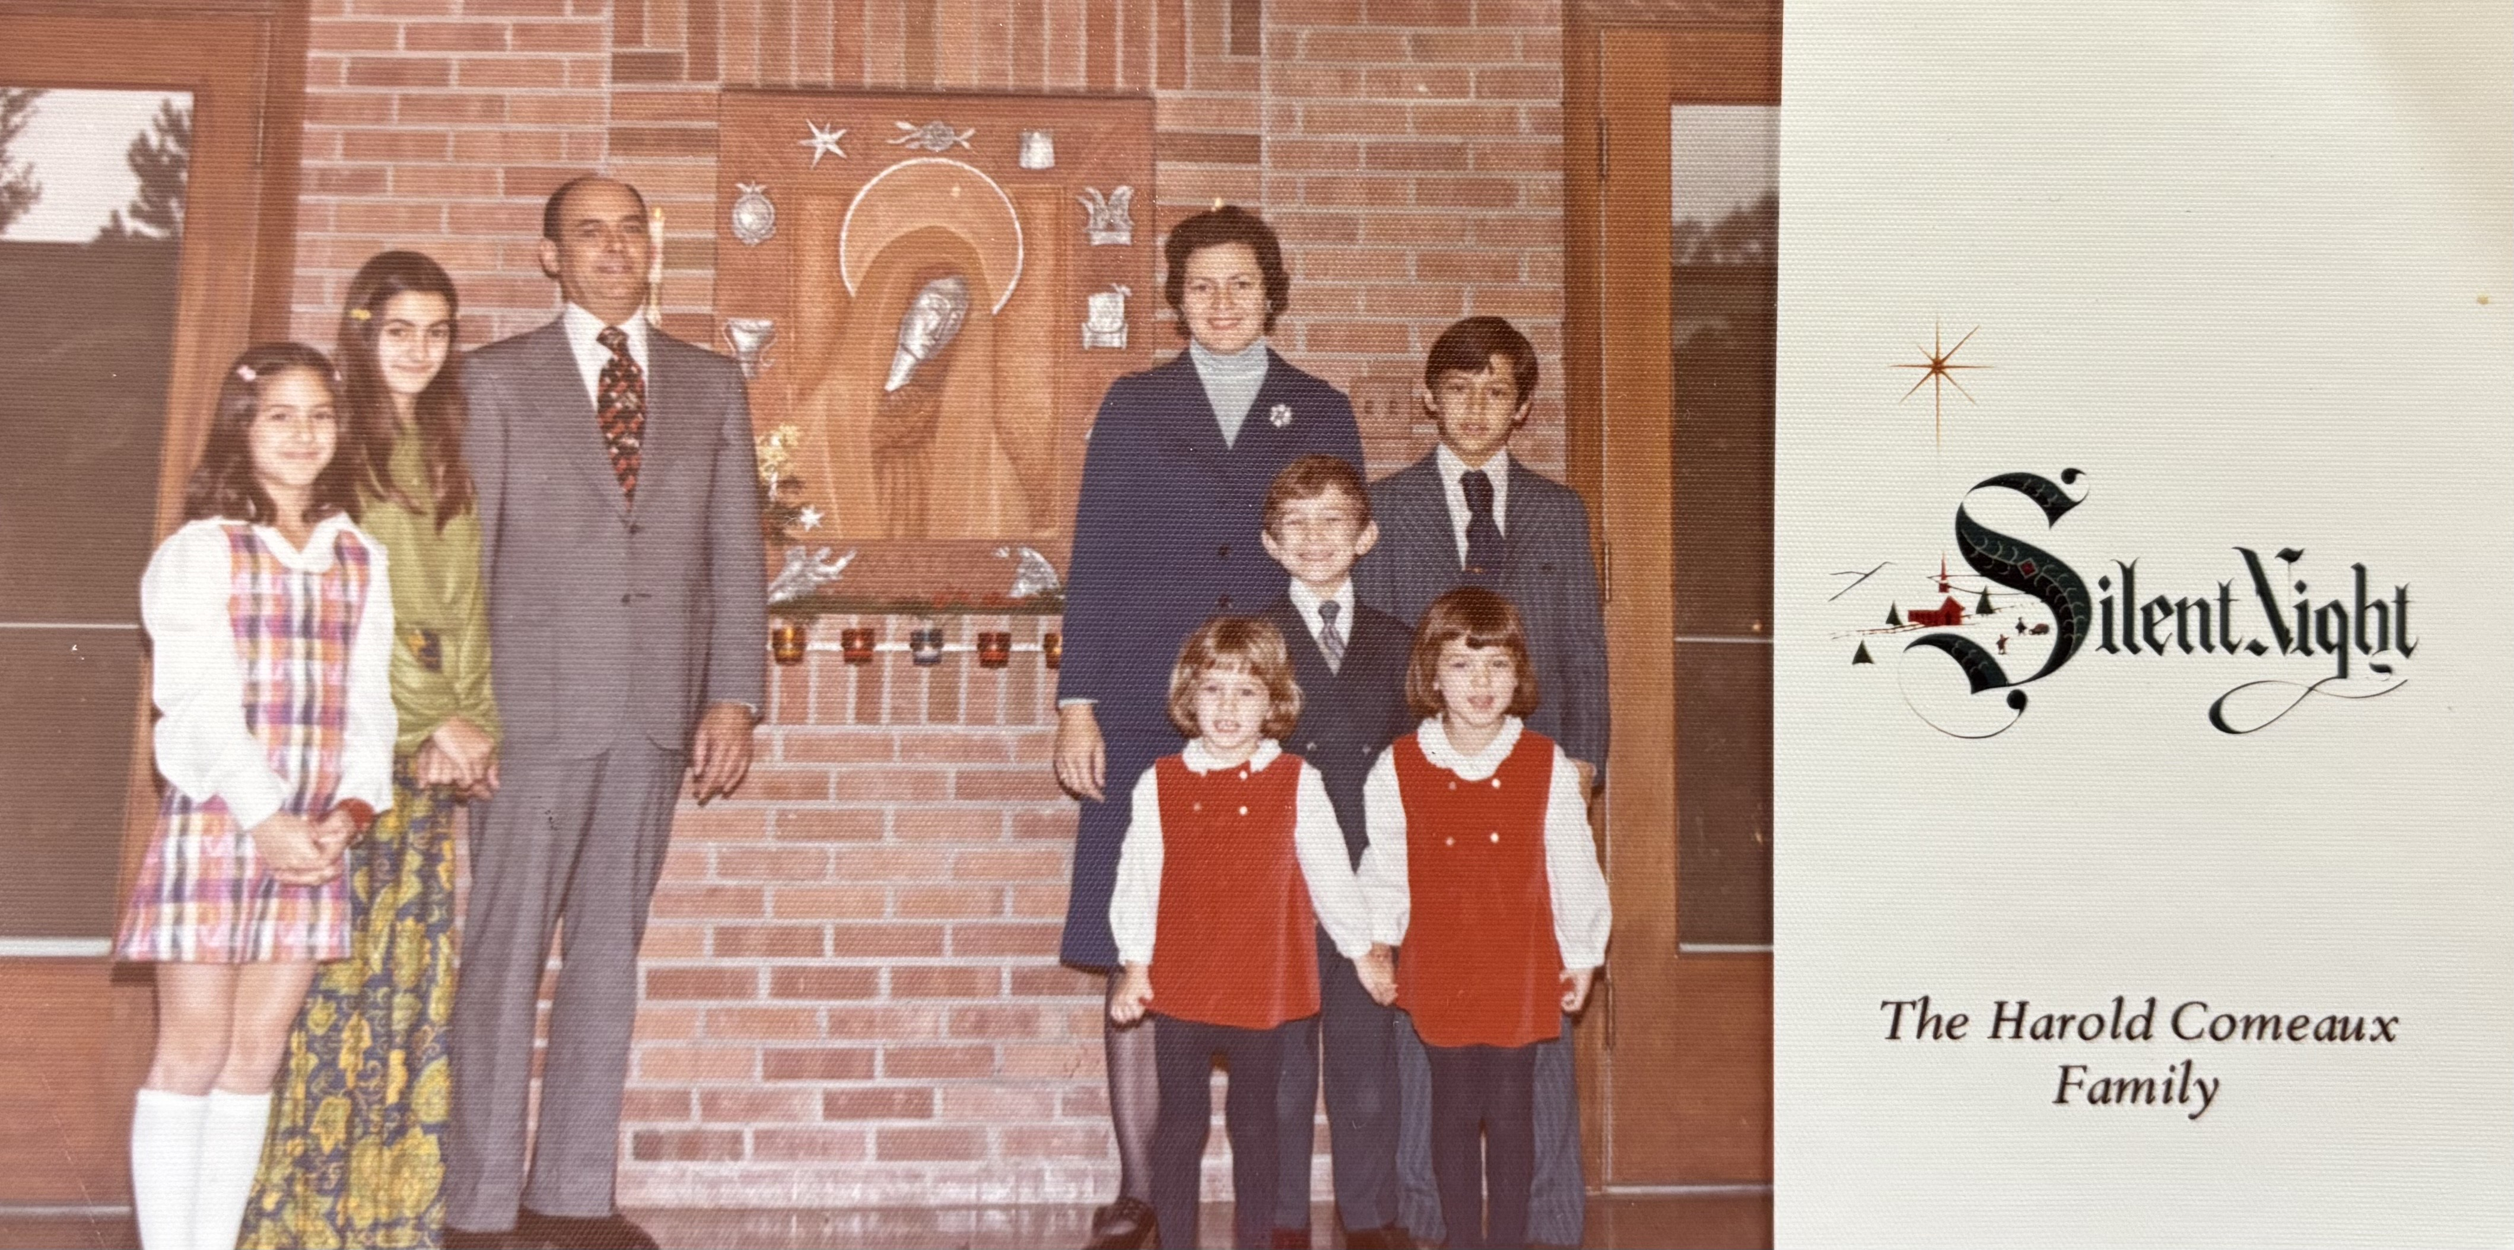

Slide 5
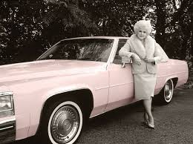
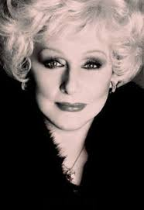

Slide 6
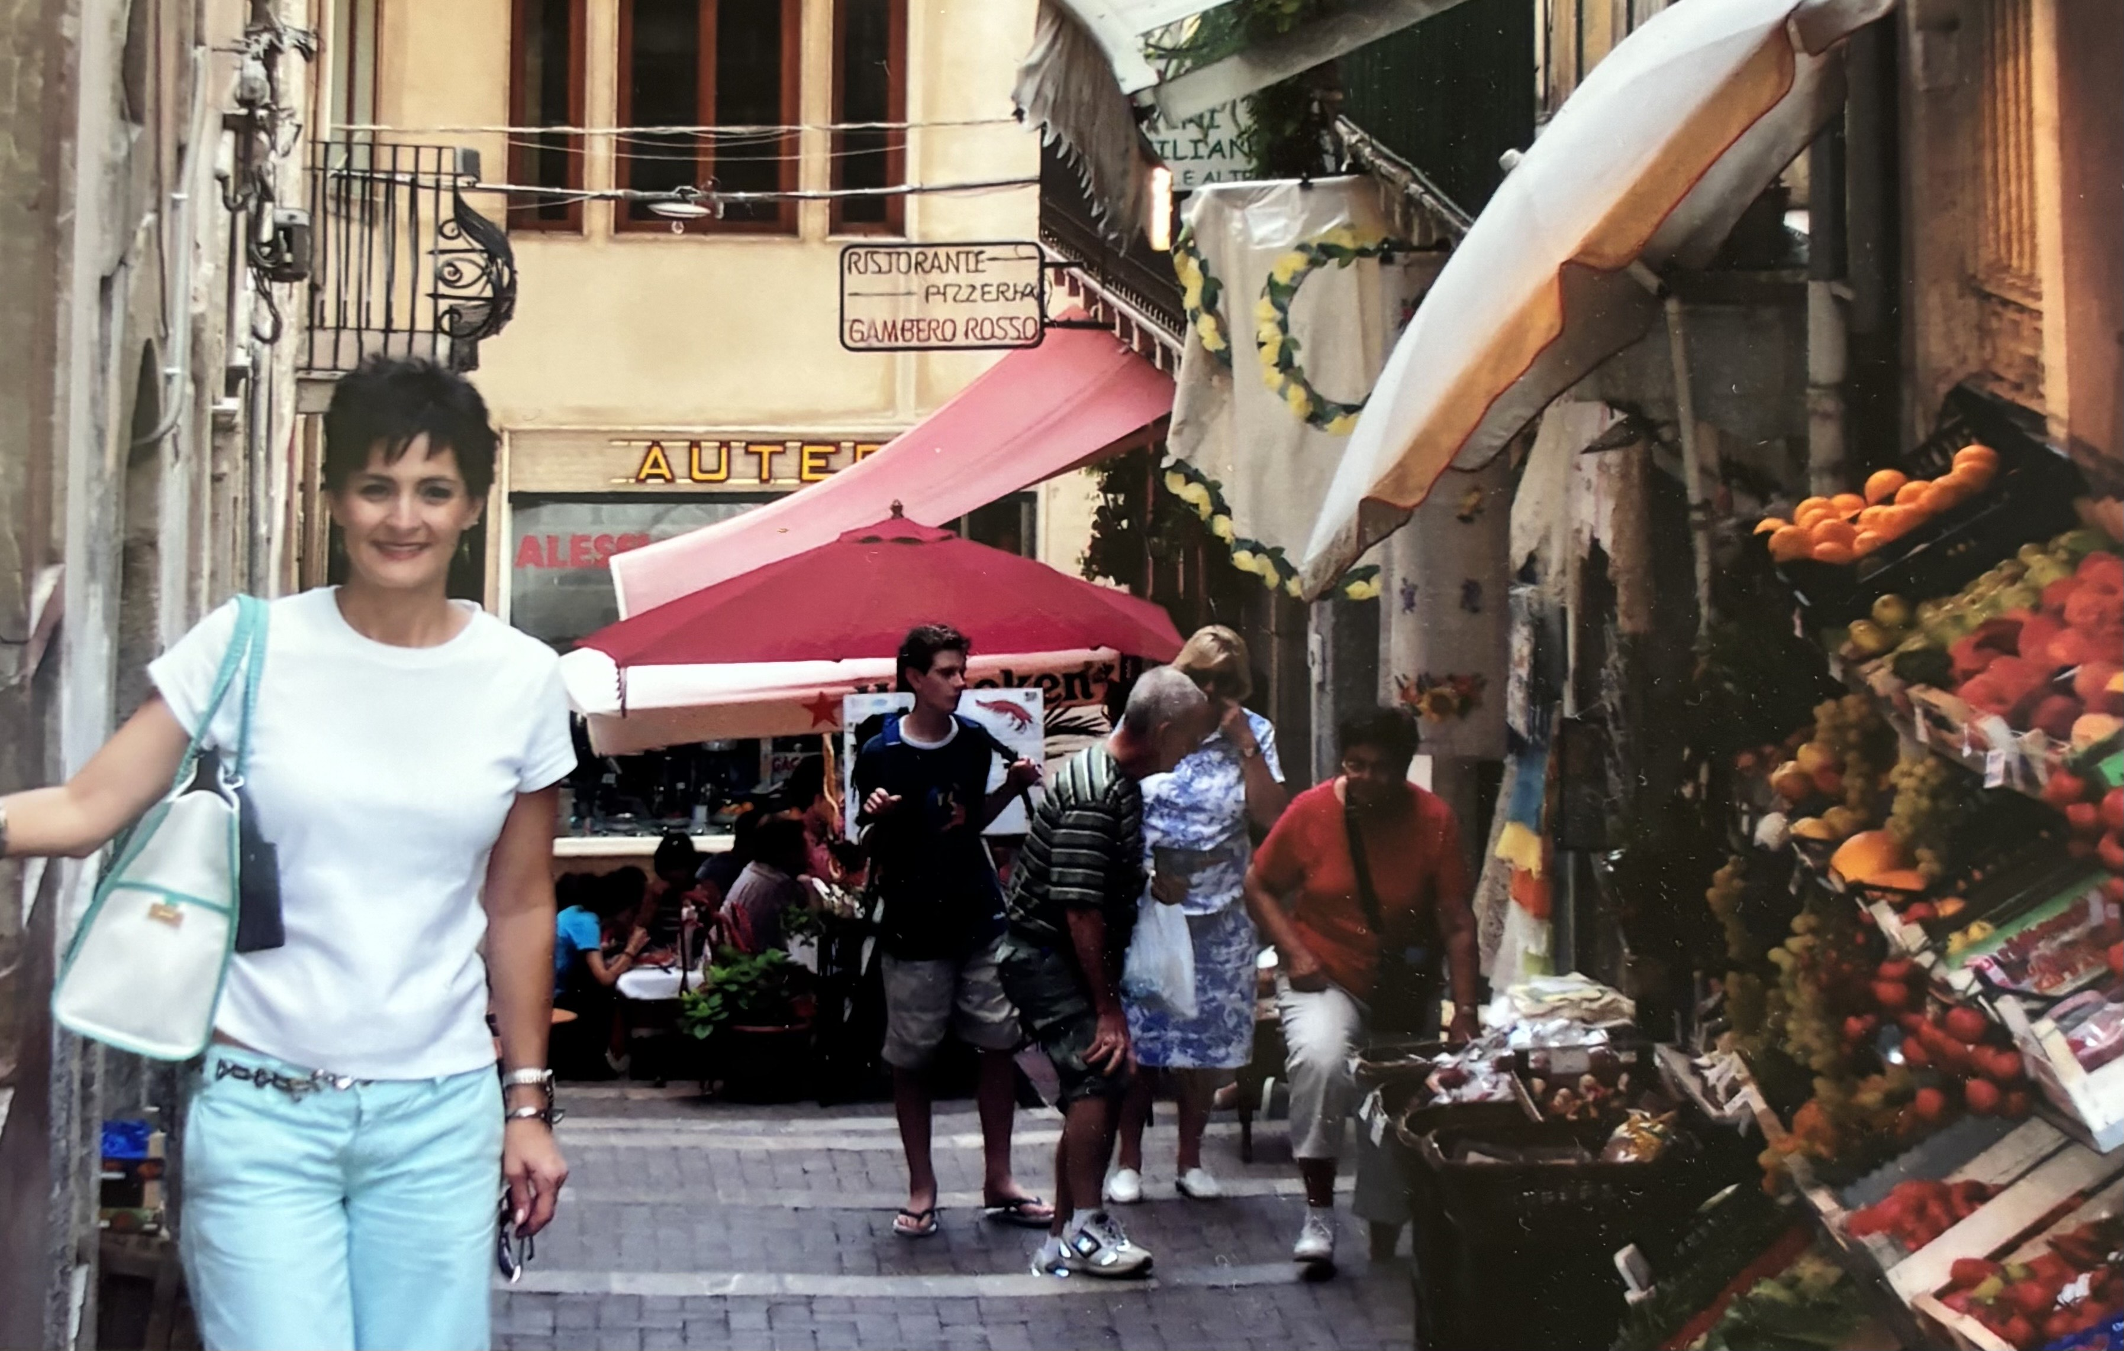
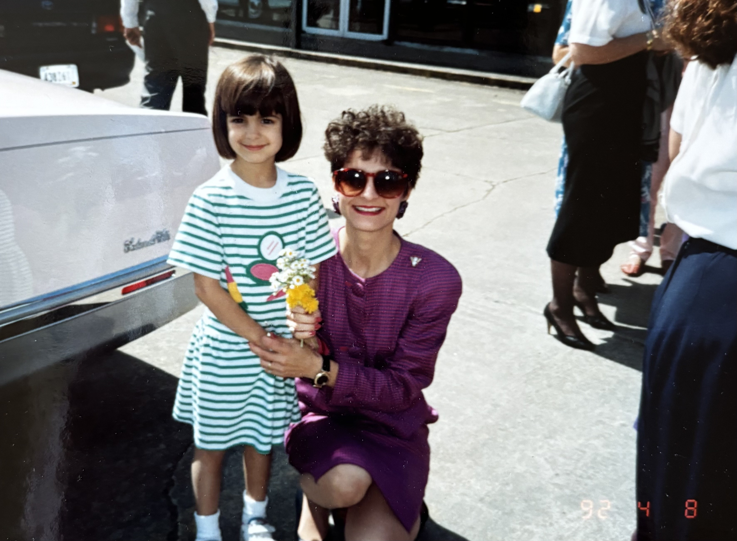
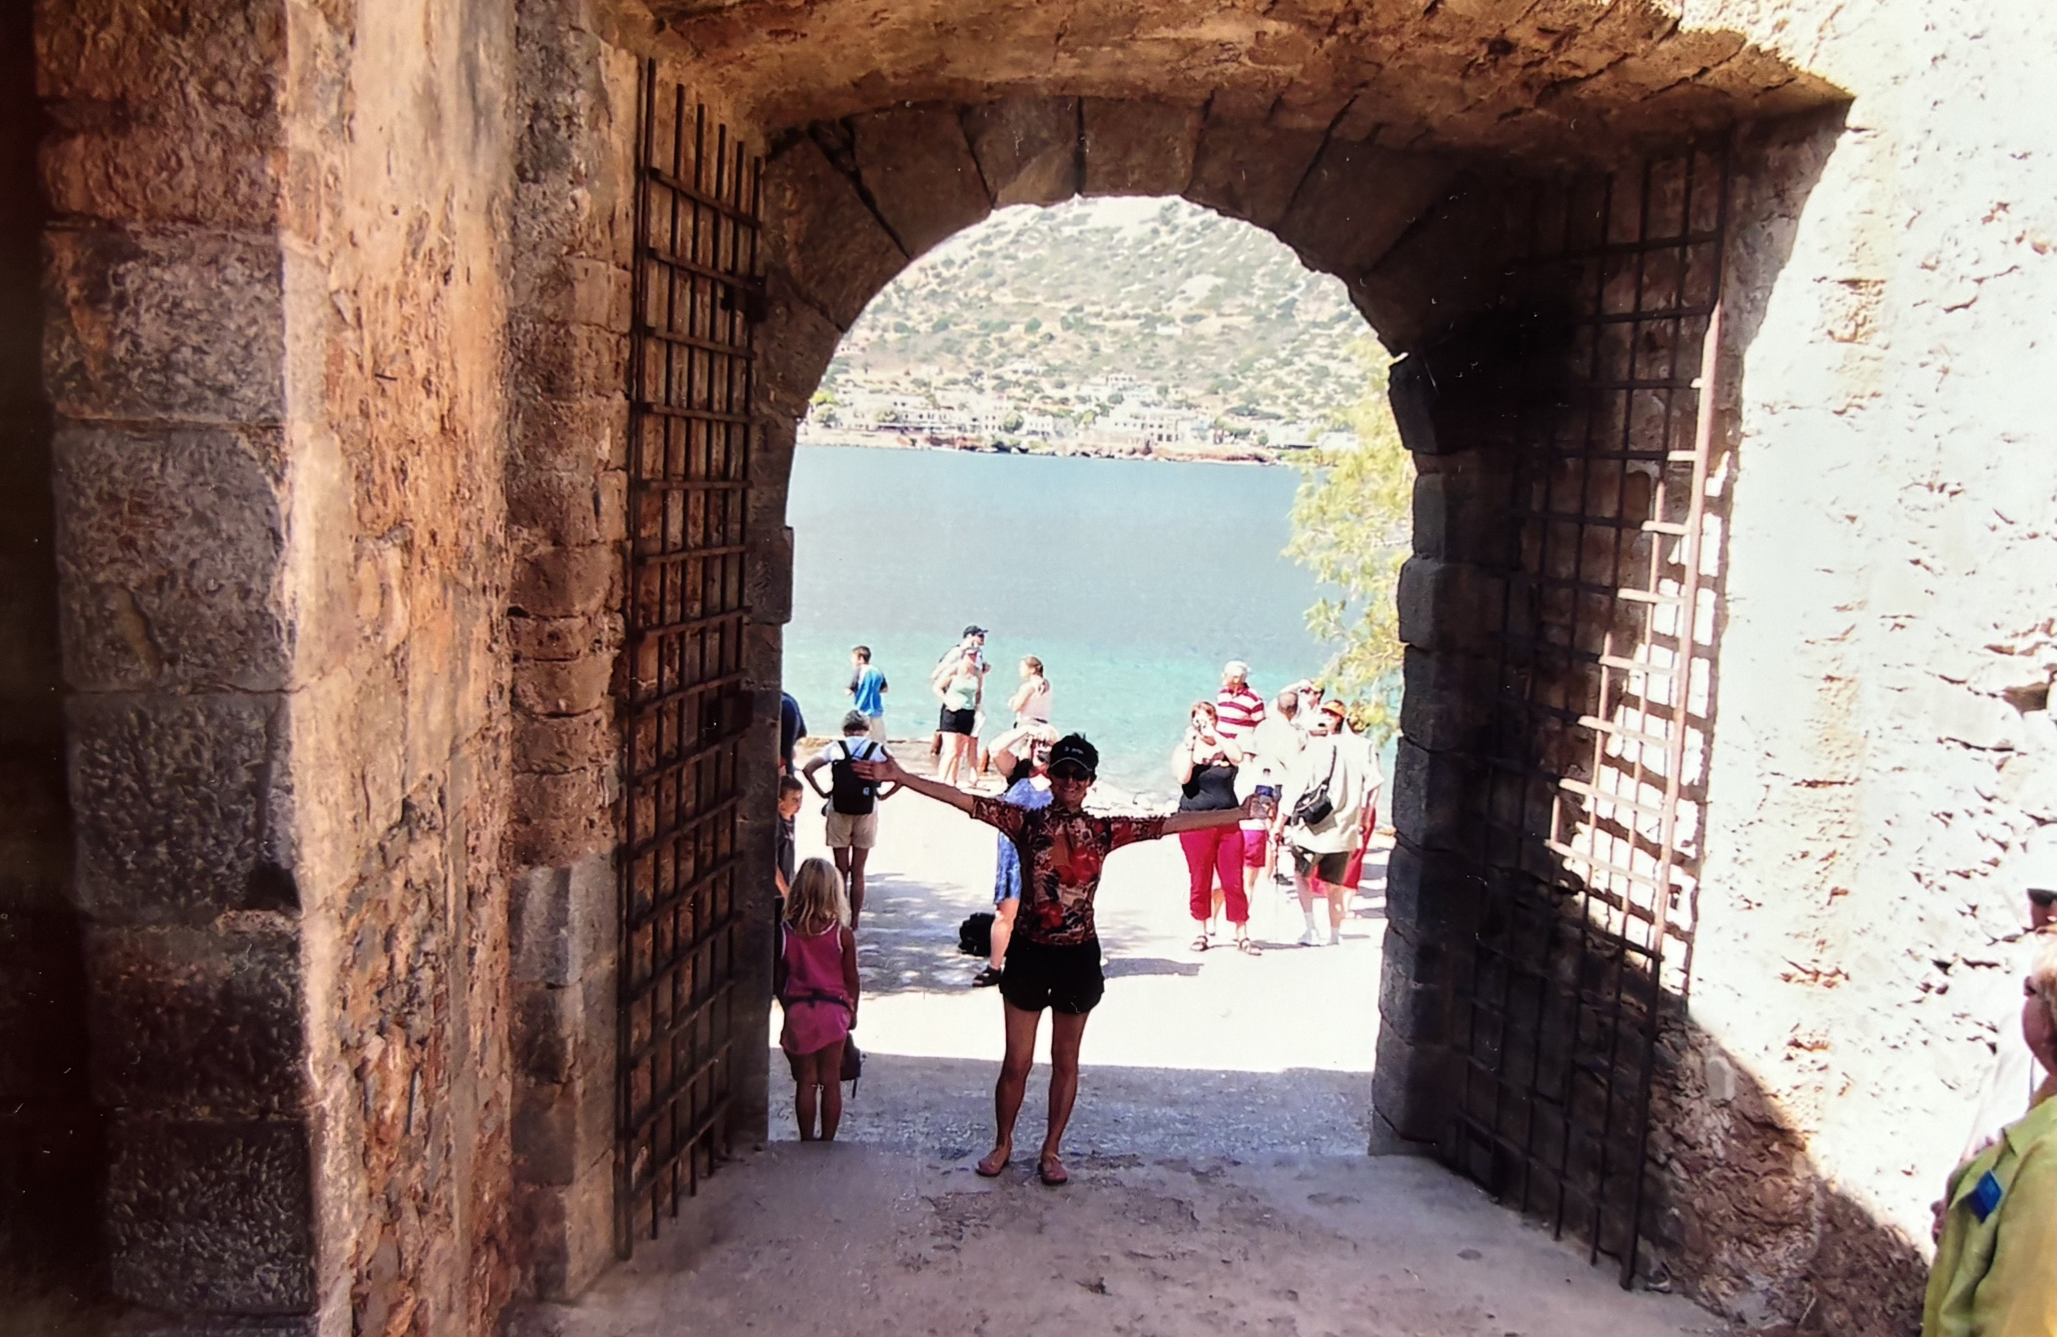

Slide 7
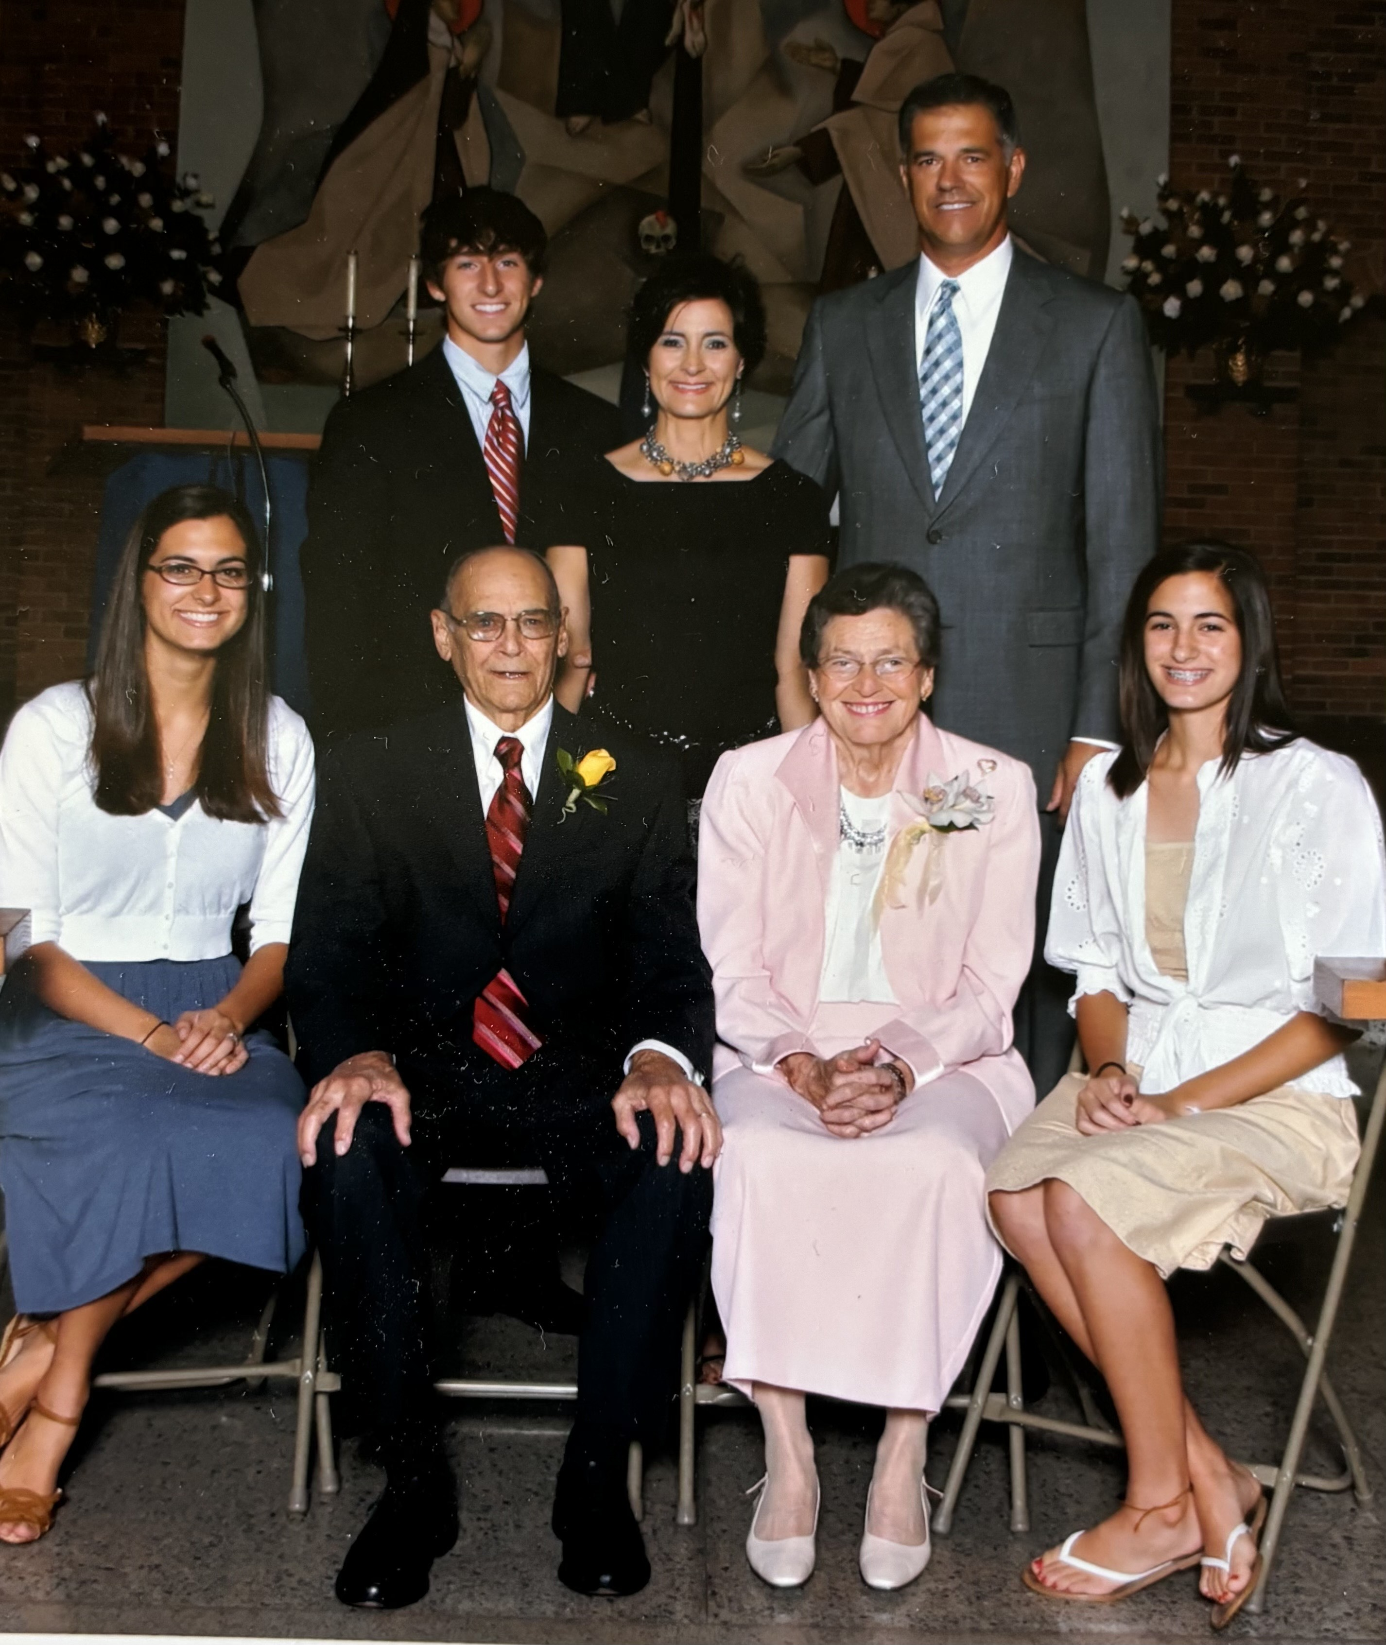
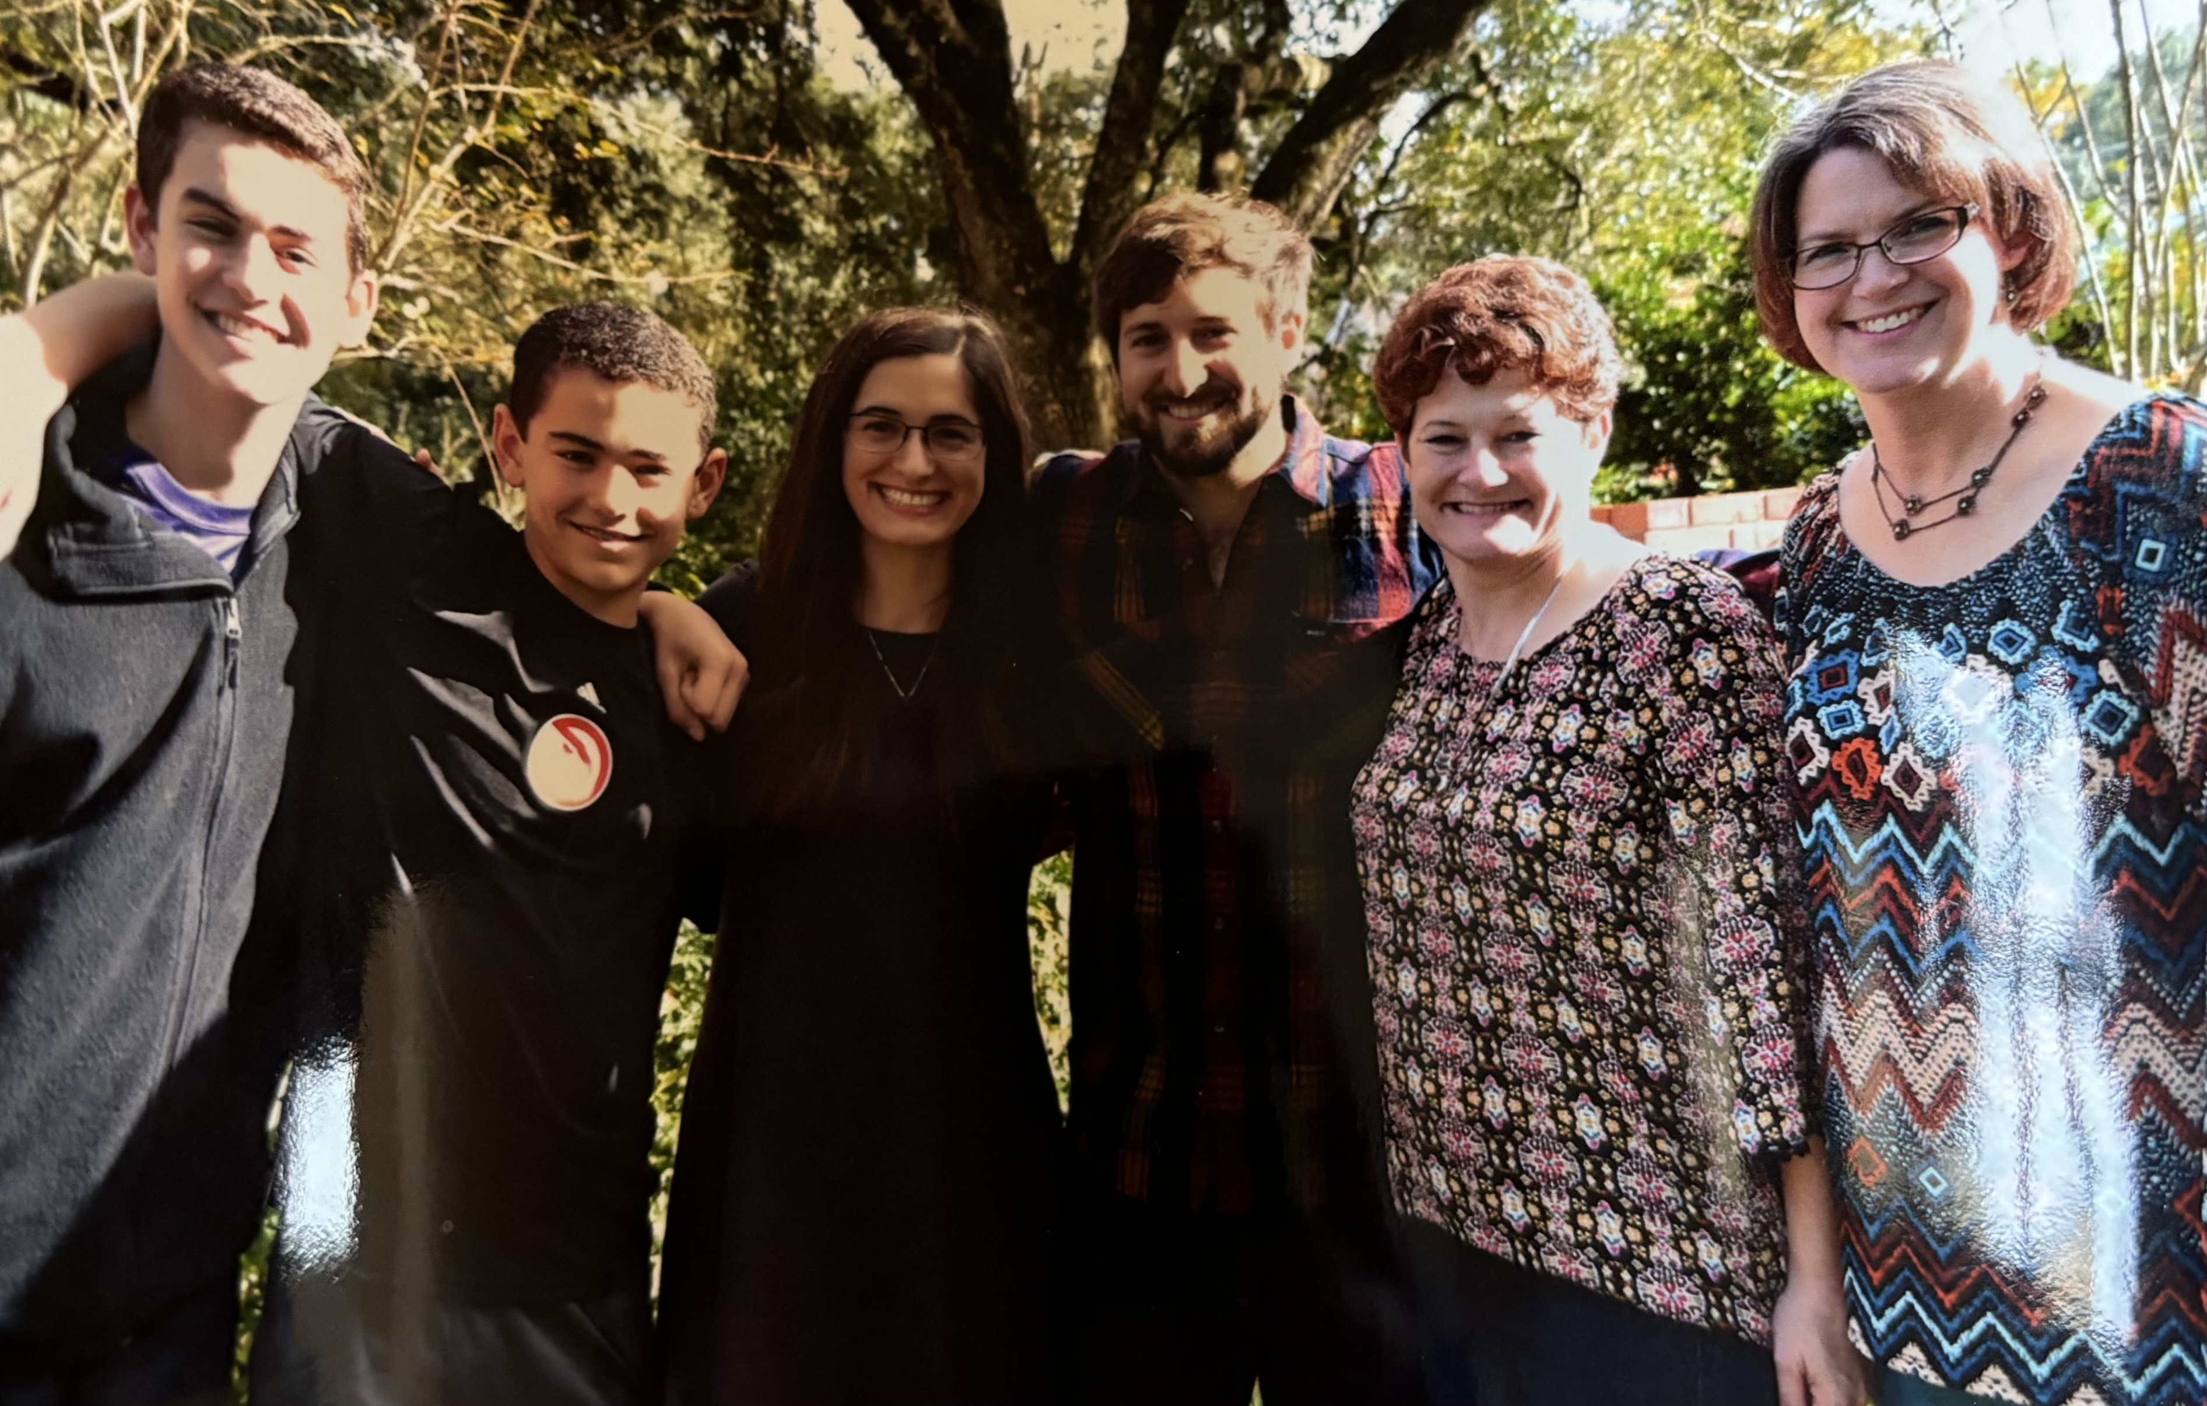
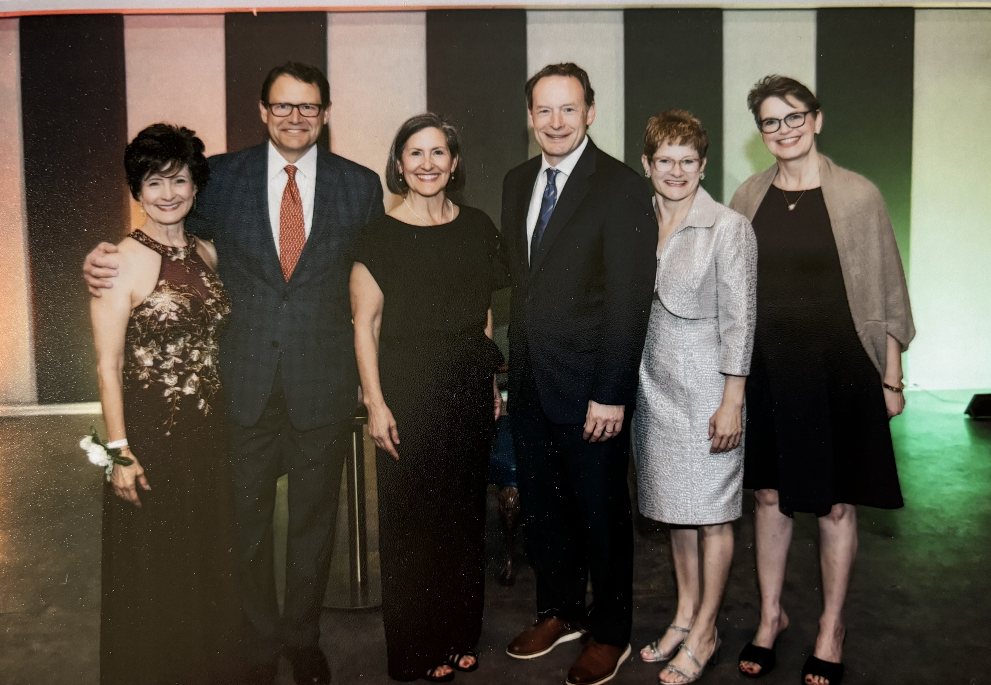

Slide 8
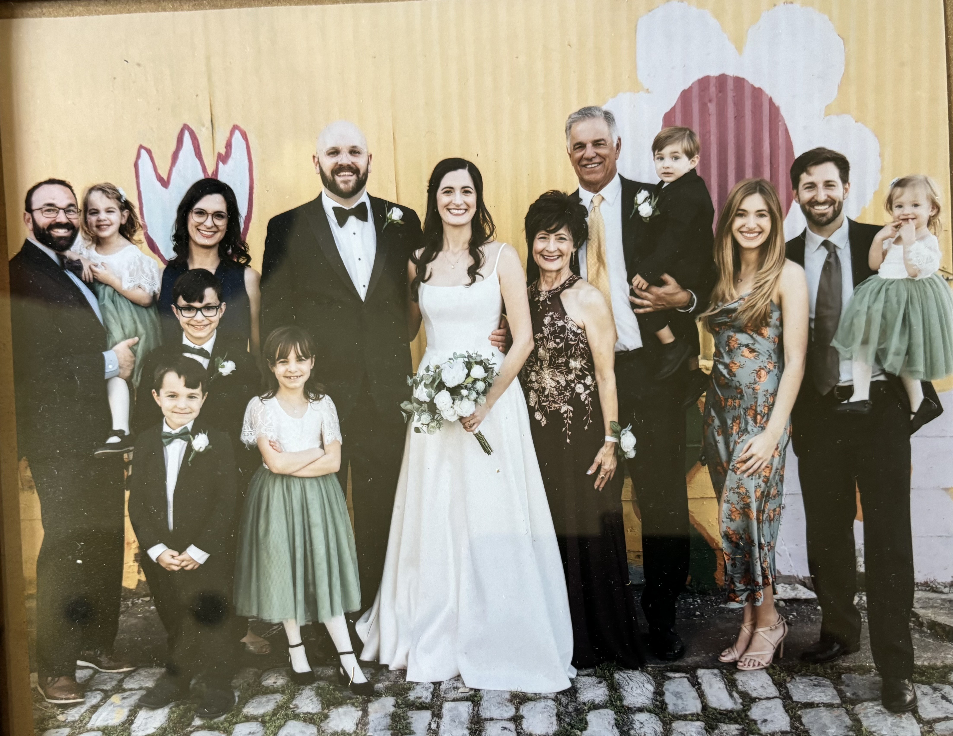
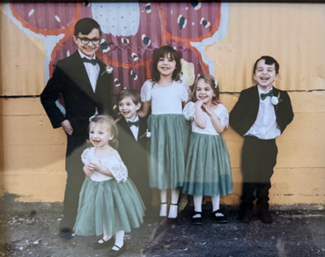

Slide 9
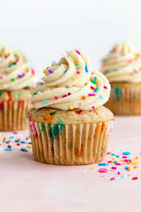

Slide 10
My theme for the year taken from 1 Thessalonians 5:16-17
“Rejoice always. Pray without ceasing. In all circumstances give thanks for this is the will of God for you in Christ Jesus!”
-Find God in all things
-Pray without ceasing
-Have an attitude of gratitude

Slide 11
Mark Comer Ruthless Elimination of hurry
1 – Slow
2 – Simplicity
3 – Silence and Solitude
4 - Sabbath

Slide 12
I wish I’d had the courage to live a life true to myself, not the life others expected of me
I wish I hadn’t worked so hard.
I wish I’d had the courage to express my feelings.
I wish I had stayed in touch with my friends.
I wish that I had let myself be happier.

Slide 13
Praying for Strangers

Slide 14
“You are already there, just not yet.”
“When you count your blessings, you always come out ahead”
“Never Complain, Criticize or Compare”
“The sand that irritates my life will turn me into a beautiful pearl”

Slide 15
Pick a practical tip to work on:
Look for God in all creatures, creation and yourself (mindfulness)
Pray for everyone and everything around you and decisions and events
Start and end each day with 3 or more things you are grateful for
Have a theme for your life, year, season, month week or day
Journal

Slide 16
Sunnyside Up Speaker Series
March 25, 2025

