Slide 1
CONSULTING
COACHING
FACILITATION
For business owners, senior managers, nonprofits and executives ready to grow.
Proud SPONS0R

Slide 2
GETTING TO KNOW YOU:
1. Where did you grow up?
2. How many siblings do you have?
3. Where are you in the line up?
4. What was an important or unique challenge of your childhood or being a kid?

Slide 3
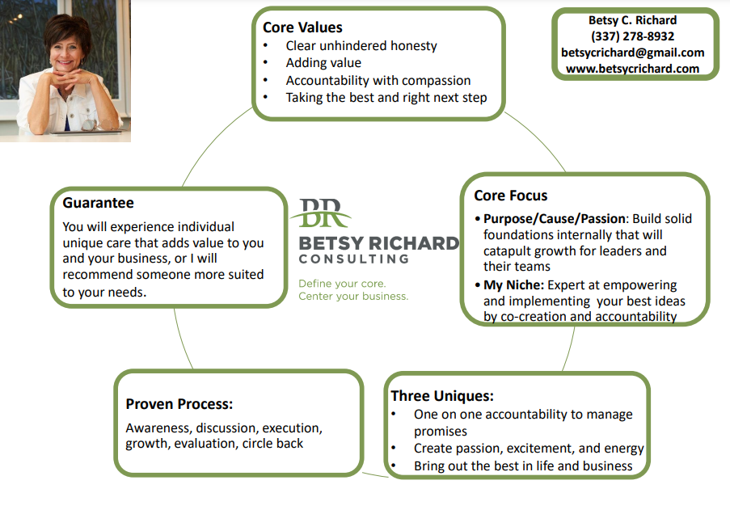

Slide 5
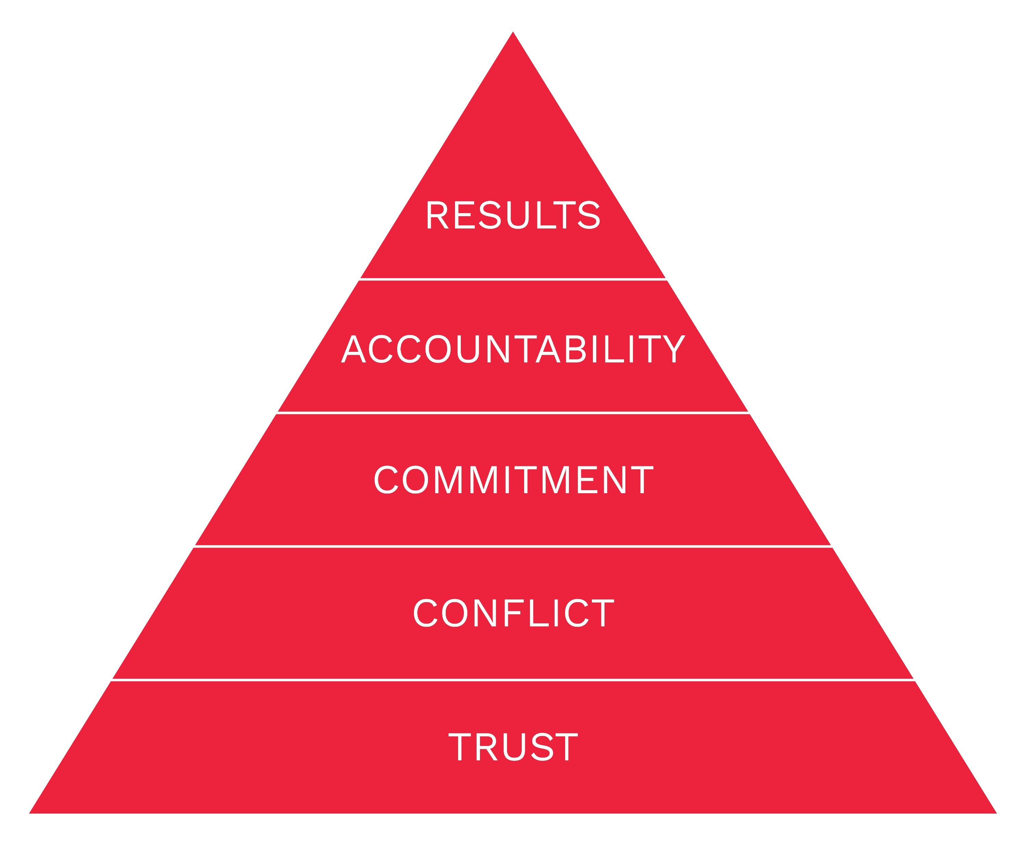
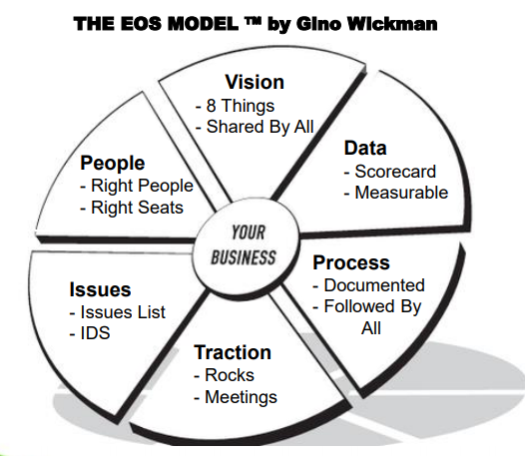
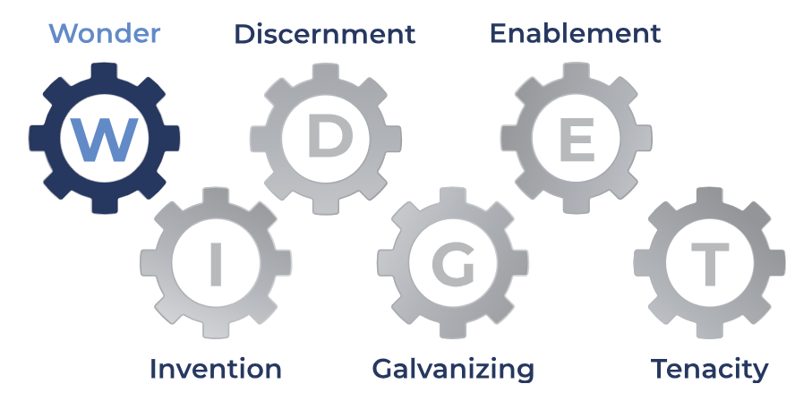

Slide 6
$1,000 Service Giveaway!!!

